Slide 1
Natwest Creditwise Pro

Slide 2
Our Team Members
Sahil
Bipish
Karan

Slide 3
Our Stackroute Mentor
Mr. Annu Sharma

Slide 4
Our Natwest Mentors
Varsha
Agarwal
Ashish
Varshney
Rohit
Sengar

Slide 5
Problem Statement
We had to build an application which suggests customized products/services to customers as per the Pull model. Customer would receive suggestions based on credit rating and can avail best loan and other product offers

Slide 6
Purpose
The purpose of the Natwest Creditwise pro is to provide a convenient and secure way for users to check their NCP score based on their Income, Liability, Employment status and Housing status and get recommendation for the relevant product basis their NCP score
Similar to CIBIL platform, customers can get their NCP score via Natwest Creditwise pro and also get the services with ease without the hassle of providing the identification documents.

Slide 7
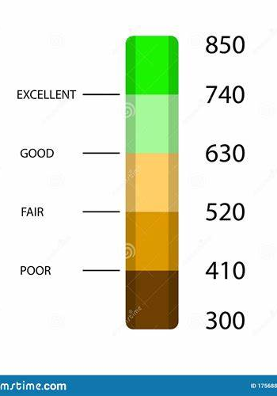
Goals
Get NCP Score
Customer can get their NCP Score based on few parameters like Income, Liability, Housing Status and Employment Status
Get products
Customer can get the products based on their NCP scores and can apply accordingly

Slide 8
Functional Requirements Register and Login: User should be able to register and login to the system in order to use the services, needs to provide the below details
First Name
Email ID
Phone no
Income
Employment Status
Password
Last Name
Date of Birth
Address
Liability
House Status
Confirm Password

Slide 9








Technology Used

Slide 10
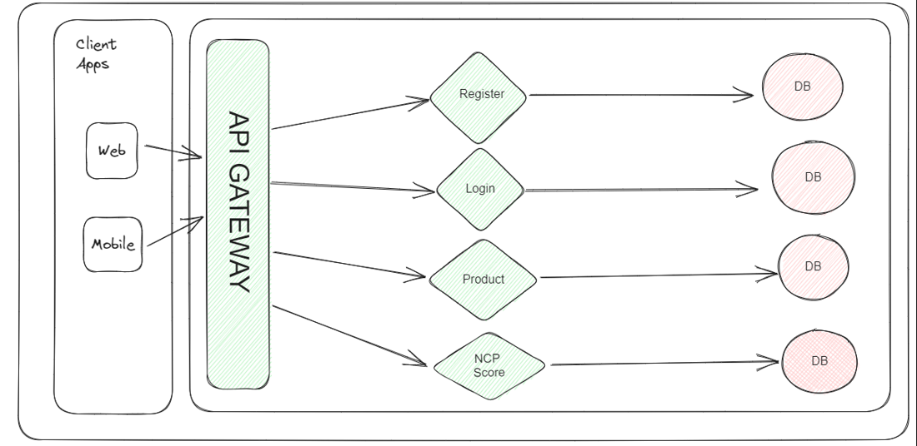
API Diagrammatic Representation

Slide 11
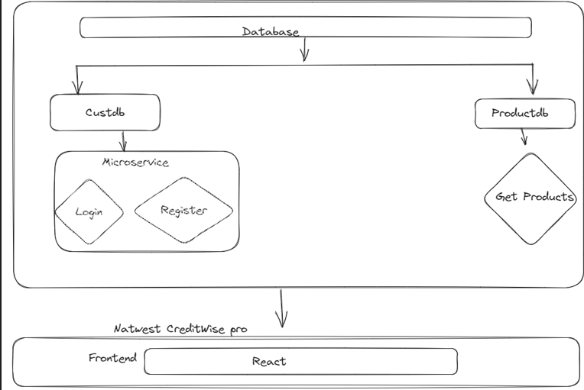
Backend Service Structure

Slide 12
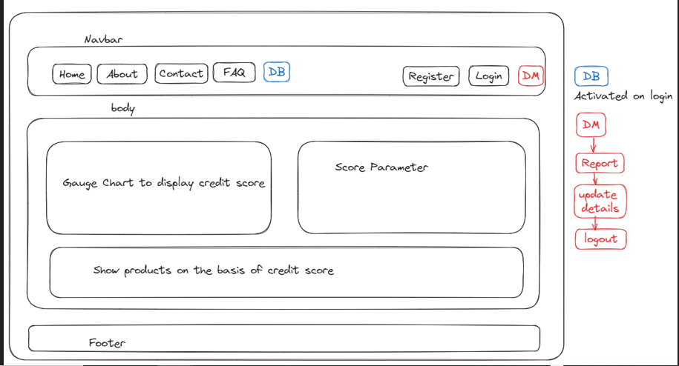
UI Diagram - Representation

Slide 13
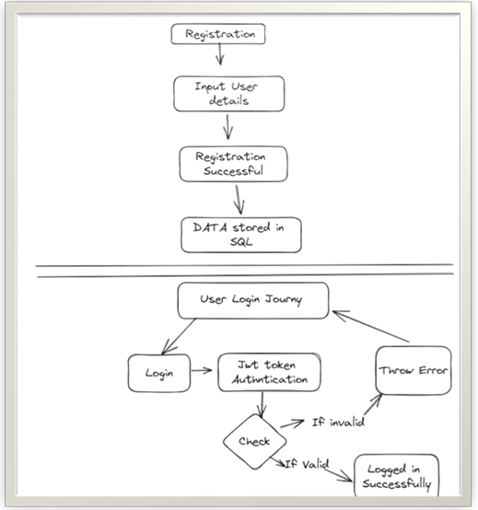
Customer Onboarding

Slide 14
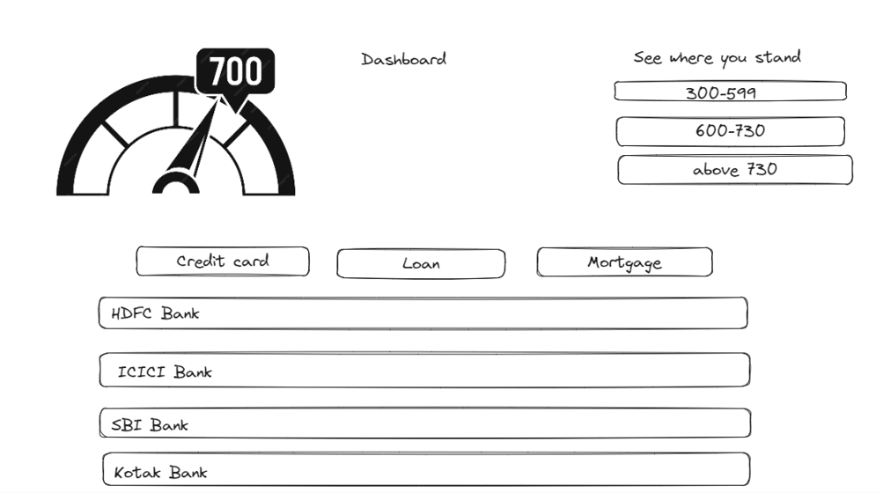
Credit Score and Relevant products

Slide 15
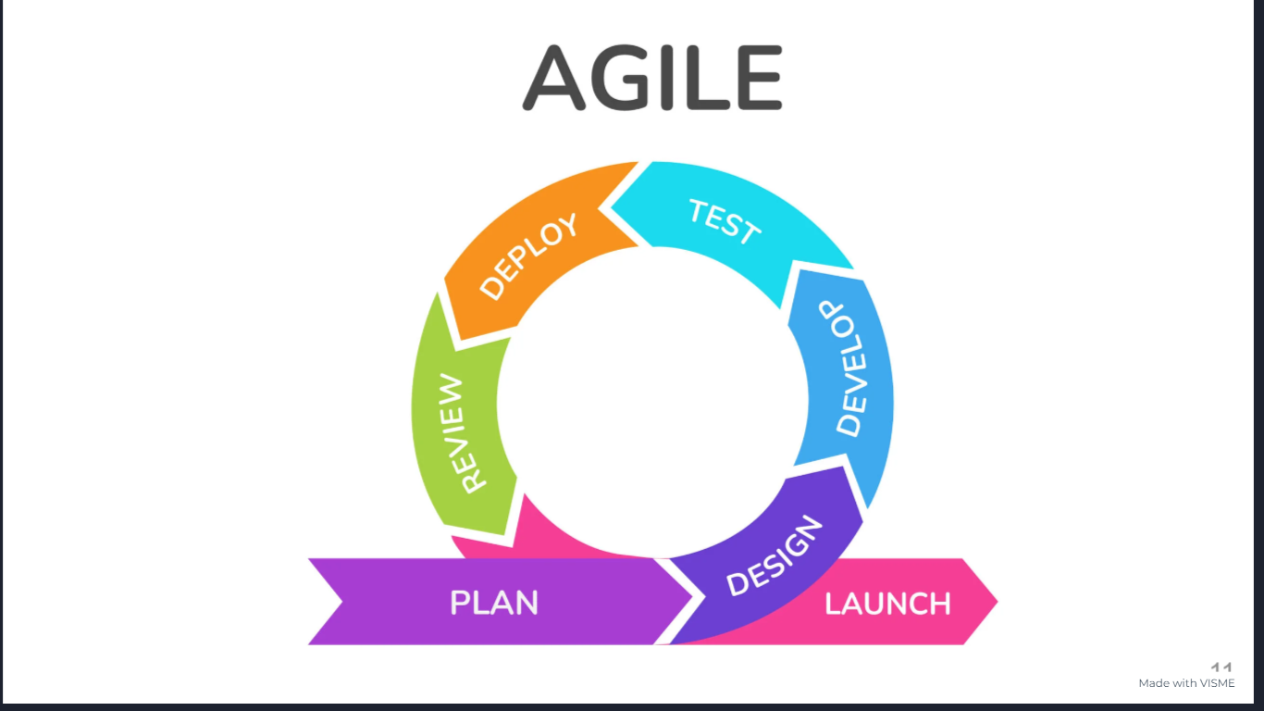

Slide 16

Code Preview

Slide 17


